Slide 1
Welcome to TCS! Your “Must do” List 2016

Slide 2

Welcome!
Welcome to Tata Consultancy Services.
You are joining more than 300,000 of the best information technology consultants and professionals in the world.
TCS North America employs more than 24,000 consultants across 45 states in the U.S. and 6 provinces in Canada, and we continue to grow. We are proud to have been recognized by Achievers as one of the “50 Most Engaged Workplaces” in both the U.S. and Canada. We are leading a number of exciting national community engagement initiatives, including our support STEM (science, technology, engineering and math) education programs such as US2020 and Million Women Mentors, partners such as NPower and STEMconnector® and we also continue to expand our own TCS goIT student technology program.
We hope you will embrace the values that set our firm apart—leadership, integrity, respect for the individual, excellence and learning & sharing. We have broad diversification with revenues spread across markets, presence across industries, and offerings across services. Our global, multicultural focus, and our agile, dynamic and flexible approach to our work helps us stay relevant to our customers, employees, and the community.
We have a singular focus on creating value for our customers, by delivering best in class services, solutions and consulting. Our work environment is demanding, results oriented, high performing, and we hope you will embrace the opportunities to realize your full potential and grow as a professional with TCS.
Surya Kant
President, TCS North America, UK & Europe

Slide 3

TCS NEW YORK CITY MARATHON
Starting in 2014 TCS is the title sponsor of the New York City Marathon.
The 2015 TCS New York City Marathon had a total of 49,617 marathon finishers.
In 2015 the official TCS New York City Marathon mobile app was downloaded 272,000 times. The app generated a 700 per cent increase in race day usage, from 7.5 million data points accessed in 2014 to 53 million in 2015.
The 2015 TCS New York City Marathon app had several new and enhanced features such as a pre-event personalized race time predictor, interactive Expo map and live leader boards of pro athletes.

Slide 4
Wealth of Information (EXTERNAL)
External (recommended links)
Tata.com
http://www.northamerica.tata.com/
http://www.tata.com/aboutus/sub_index/Governance
http://www.tata.com/company/index/Tata-companies
http://www.tata.com/htm/Group_MnA_CompanyWise.htm?sectid=Mergers-and-acquisitions
http://www.tata.com/htm/downloads.htm?sectid=Downloads
tcs.com
http://www.tcs.com/about/corp_responsibility/Pages/default.aspx
http://www.tcs.com/about/corp_responsibility/cs-report/Pages/default.aspx
http://www.tcs.com/about/corp_facts/Pages/default.aspx
http://www.tcs.com/resources/brochures/Pages/Corporate-Brochure.aspx
http://www.tcs.com/investors/Pages/default.aspx

Slide 5


Recommended Readings
Author: Harish Bhat
Among the engaging and inspiring stories told here are those of Tata Indica, the first completely Indian car that succeeded in the face of widespread cynicism; the jewellery brand Tanishq that has transformed one of India’s largest industries; and Tata Finance, which underwent several tribulations yet demonstrated the principles which Tata stands for. Written by a TATA insider, TATAlog reveals the DNA of every TATA enterprise—a combination of the virtues of being pioneering, purposive, principled and ‘not perfect’, along with tremendous human effort
TATAlog: Eight Modern Stories from a Timeless Institution
Author: Morgen Witzel
A series of high-profile acquisitions, including Jaguar Land Rover and Corus Steel, together with the launch of the Nano (the world’s first Rs. 1 Lakh/below US$ 2500 car), is set to change our perception of India‘s oldest and most respected corporate brand. With a major international presence, in a variety of areas including steel, tea, chemicals, communications and software, Tata now stands 65th in the world brand valuation league. But what is the Tata brand all about? What are its values? How do people perceive it, in India and around the world? In this absorbing and informed book Morgen Witzel digs into the heart of the Tata enterprise, describes its origins, how Tata's reputation and image evolved, and how the group has worked to transform that image into a powerful and valuable brand.
“TATA: The Evolution of a Corporate Brand”

Slide 6


Recommended Readings (Contd..)
Author: R.M. Lala
Author: When Jamsetji Tata started a trading firm in 1868, few could have guessed that he was also opening an important chapter in the making of modern India. Jamsetji saw that the three keys to India's industrial development were steel, hydroelectric power, and technical education and research. A century and a half later, the TATAs can claim with justice to have lived up to the vision of their founder.
The Creation of Wealth - The TATAs From 19th to 21st Century
Author: S. Ramadorai
In 2003, Tata Consultancy Services set itself a mission: Top Ten by 2010 . In 2009, a year ahead of schedule, TCS made good on that promise: in fourteen years, the company had transformed itself from the $400 million operation that S. Ramadorai inherited as CEO in 1996, to one of the world s largest IT software and services companies with more than 160,000 people working in forty-two countries, and with annual revenues of over $6 billion. The TCS story is one of modern India s great success stories. In this fascinating book, S. Ramadorai, one of the country s most respected business leaders, recounts the steps to that extraordinary success
The TCS Story … and Beyond

Slide 7
Wealth of Information (INTERNAL)
Staying connected through Ultimatix (connecting 300000 associates globally!)
Knowmax-TCS’s Knowledge Management portal Go to Knowmax for details on policies/your OU/technical documents etc. (Ultimatix>>Learning & Collaboration>>Knowmax (under Knowledge Management)
Knome-TCS’s social media platform for collaboration and networking Knome allows you to form groups and reach out to other TCSers and collaborate (Ultimatix>>Learning & Collaboration>>Knome (under collaboration)
TCS’s monthly in-house magazine @TCS e-zine (news and media tab) @TCS e-zine gives you a glimpse of all happenings around the TCS world every month
TCS Video channel- https://video.tcs.com (requires Ultimatix credentials)
https://video.tcs.com/play?nid=tcsp4l&context=_nfpb&_pageLabel=l_logo (CEO on purpose4life)
https://video.tcs.com/play?nid=pe250cropped&context=_nfpb&_pageLabel=l_logo (CEO on performance ethic)
https://video.tcs.com/play?nid=ec2250&context=_nfpb&_pageLabel=l_logo (CEO on Experience Certainty)
https://video.tcs.com/play?nid=ceomessage&tags=_451cCXsb&_pageLabel=l_logo (CEO on Fit4Life)
https://video.tcs.com/play?nid=knome&tags=_451cCXsb&_pageLabel=l_logo (Enriching lives through Worklife communities)
The pen drive in your welcome kit has a video on the TATA group and a presentation about TCS

Slide 8
Important Message
This call will cover the basics of Ultimatix navigation only in order to ensure that all the necessary information is provided by you
The Reference Guide sent to you has the details of this navigation along with screen shots
There is a “Benefits” (401k/health/perquisites etc.) call done on Wednesday using the same link and at the same time
The Session 1 Induction call occurs Monday, Tuesday, Thursday and Friday and the Session 2 Induction call on Wednesday are recurring calls. If you miss one, you could attend the call, the following week. Note that the call details are valid for the entire year.

Slide 9
First Time Set up in Ultimatix

Slide 10
Prerequisite to access Ultimatix-Employee Number
To access Ultimatix you will need your employee number
You will receive your TCS Employee Number (at the email address provided on the application) up to 72 hours after your initial start date.
Within 12 hours of receipt of your Employee Number you will receive access to Ultimatix
You will be able to login, create your email id and also initiate other processes

Slide 11
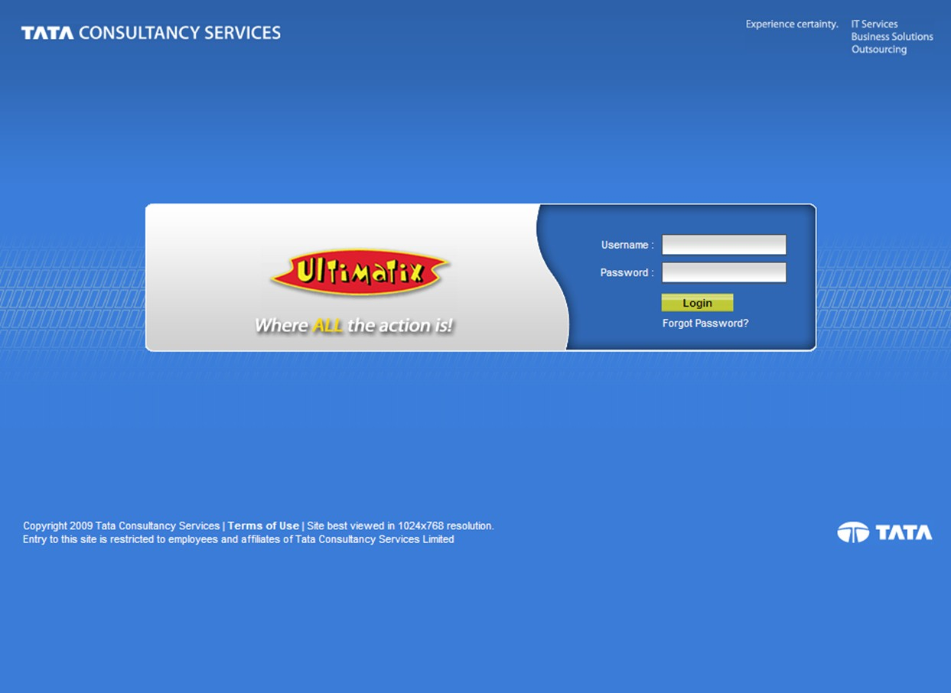
Ultimatix Overview - https://www.ultimatix.net
Password Requirements
1 Capital Letter
1 Number
1 Special Character
Minimum of 8 Characters
User Name is your Employee ID # Default Password is ChangePwd@your date of birth in the ddmmyyyy format

Slide 12
Password Management- Resetting passwords
The Password Management section allows you to change your passwords at any time.
In the event you lock yourself out of Ultimatix you can reset it by clicking on “Forgot my Password” and reset it yourself using your “Secret Question”.
To set up your 5 mandatory Secret Questions:
Please click on the Password Management tab on the upper right hand corner of the Ultimatix Homepage.
Once the page has loaded please click on Secret Question. Set up your secret questions and answers.

Slide 13
Navigation through Ultimatix-First time set up
Complete these in week ONE
You must create your email id immediately. All TCS communication is sent via email to your TCS id.
Email id
If you wish to receive direct deposits of your pay please update your Bank Details in Ultimatix
In order to view your pay stub, please register at I Pay. You may need some of the details from your first check’s pay stub. (details also available in the reference guide)
Bank Details for Payroll

Slide 14
Navigation through Ultimatix-First time set up (Contd..)
Complete these in week ONE
Claim reimbursements are paid to you by direct deposits only. You must enter your bank details to receive the amounts towards reimbursements of official expenses incurred.
Bank Details for Claim Reimbursements
Your Basic Details
Your home address
Your SSN
Your dependent details
W4
Important Information-Prerequisite to Benefits Enrollment
Please watch the video in your pen drive called New Hire Ultimatix Steps’ to see the navigation through Ultimatix to complete these steps

Slide 15
Recurring Processes

Slide 16
Recurring Processes
You will access the following applications more frequently that the others-
Timesheets
Leave
Travel
Claim Reimbursement
All of these except Timesheets are available through GESS or Global Employee Self Service in Ultimatix
You can access GESS from the home page under “Tag Cloud”
Please watch the video in your pen drive on how to fill in Timesheets (Timesheet – FLSA – Video Learning.)
This will take you through the navigation in Ultimatix for correctly filling in Timesheets.

Slide 17
Recurring Processes
Timesheets
You need to clock in your work hours preferably EVERYDAY but at least every Friday (6 p.m. local time) for the week. The time logged is an indication of work done and impacts invoicing and many other processes
Leave
You can apply for leave based on your eligibility through Ultimatix. It is important that you plan your leave after discussions with your supervisor. (Further details of the policy are provided in the call on Wednesday. Additionally the policy document is available on Knowmax)
Recurring Processes
Travel
Your position at TCS may require some travel. TCS has a convenient way of booking all air and train travel using Ultimatix for all Business travel
Claim Reimbursement
You can claim reimbursements of official expenses through Ultimatix. TCS allows ‘Straight Through Employee reimbursement processing’ (STERP) which processes claims the very next day of their application in Ultimatix.

Slide 18
Please go through the Reference Guide for completing all the processes in Ultimatix

Slide 19
Additional Information

Slide 20
Emergency Contact Information
In the event of an emergency it may be necessary for TCS to get in touch with someone close to you.
Please add your emergency contact details
Ultimatix Homepage >> GESS>>My Profile>>About >>Basic Details
In tab Emergency Contact details, you can Add/Edit Emergency Contact Details

Slide 21
Global Helpdesk
You will need to raise a ticket for a number of your requirements
For conference number facility (depending on role)
Syncing up email on your iPhone
And others
From the Ultimatix Home Page click on
Employee Services>>TCS Global Helpdesk>>IT services and others>> Launch
Once you complete the ticket and receive a ticket number you can contact the Global Helpdesk at 1-877-827-4639 or 732 590 2727
If you have locked yourself out of Ultimatix before you set up your “secret questions” and you have not created a TCS email ID then you must email Denise Deluca to reset your password.
The email should contain your
Employee ID
Date of Joining
Date of Birth

Slide 22
Global Helpdesk
You will need to raise a ticket for a number of your requirements
For conference number facility (depending on role)
Syncing up email on your iPhone
And others
From the Ultimatix Home Page click on
Employee Services>>TCS Global Helpdesk>>IT services and others>> Launch
Once you complete the ticket and receive a ticket number you can contact the Global Helpdesk at 1-877-827-4639 or 732 590 2727
If you have locked yourself out of Ultimatix before you set up your “secret questions” and you have not created a TCS email ID then you must email Denise Deluca to reset your password.
The email should contain your
Employee ID
Date of Joining
Date of Birth

Slide 23
2016 Holidays
US HOLIDAYS 2015 | Date | Day
New Year's Day | 1-Jan-16 | Friday
Martin Luther King, Jr.’s Birthday | 18-Jan-16 | Monday
Presidents' Day | 15-Feb-16 | Monday
Memorial Day | 30-May-16 | Monday
Independence Day | 4-Jul-16 | Monday
Labor Day | 5-Sep-16 | Monday
Thanksgiving Day | 24-Nov-16 | Thursday
Day after Thanksgiving | 25-Nov-16 | Friday
Christmas Eve | 23-Dec-16 | Friday
Christmas Day (DAY AFTER) | 26-Dec-16 | Monday
All associates onsite with clients are expected to follow the client’s holiday schedule.
If the client has less than 10 holidays, associates may take an ‘earned’ holiday within the same calendar year with the approval of the TCS manager.
Associates who have any questions pertaining to their eligibility to participate in this holiday schedule should contact their HR talent engagement partner.

Slide 24
2016 Payroll Calendar

Slide 25
Glossary
There are a number of acronyms used in TCS. Access this link in Knowmax to get a complete glossary of terms.
https://iqmskm.ultimatix.net/km/index.php/GL_Abbreviation

Slide 26
Your Reference Guide
The detailed steps of the all the processes discussed today are in the embedded presentation (Your Reference Guide).
Please complete all “first time set up” processes in Week One
For assistance, please reach Denise at - Denise.deluca@tcs.com

Slide 27
Q & A

